Slide 1
IMPROVING THE PERFORMANCE TOOLS
Damien Dosimont
Barcelona, 08/01/2016

Slide 2
Work on Folding

Slide 3
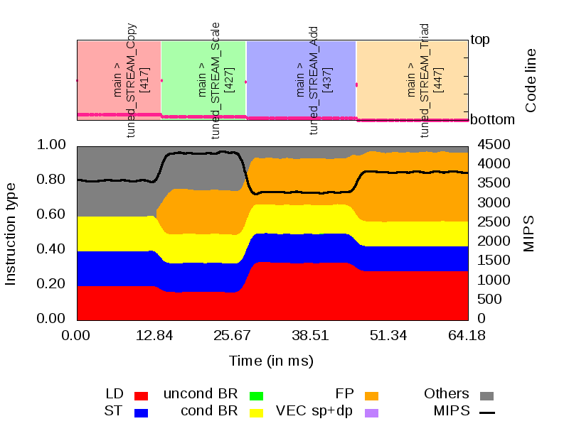
Initial Objective
Improve the relevant routine identification (RRI) and representation to correlate better performance bottleneck and source code
Colored areas: representative functions
Dots: code lines
Performance metrics
[Servat’s Ph.D thesis]

Slide 4

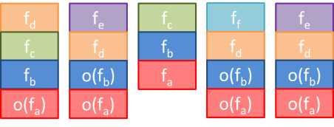



Summary of the current processing flow
Samples, routines/callstack level
RRI graph
Clustered trace files
(with sampling)
Performance metrics

Slide 5

Improving RRI: first approach
Samples, routines/callstack level
RRI graph
Intervene directly on the RRI graph generation
Clustered trace files
(sampling enabled)
The idea: help to automatically tune the parameters that lead to a RRI representation in order to select the best ones.
A « good representation » provides the user with insight (information is preserved) while staying clear and readable (low graphical complexity).

Slide 6
Improving RRI: second approach
Samples, routines/callstack level
Clustered trace files
(sampling enabled)
RRI aggregated representation
The idea: use a method based on aggregation and information theory, appropriate to discriminate phases/homogenous or heterogeneous behaviors.
This method is applied on a model built upon the sample/routine/callstack level data.

Slide 7
Improving RRI: third approach
RRI aggregated representation
Samples, routines/callstack level
Clustered trace files
(with sampling)
Phases discovered from perf. metrics
Performance metrics
The idea: apply the aggregation method on the performance metrics, and distinguish phases.
Identify, for each phase, the most relevant routine(s).

Slide 8
First approach: find automatically the best representations

Slide 9

Recall: Current technique
Depth of a routine changes in the call-stack
Align call-stacks through an MSA-inspired algorithm
Top
f_{d}
f_{e}
f_{c}
f_{f}
f_{e}
Depth 1
f_{c}
f_{d}
f_{b}
f_{d}
f_{d}
f_{b}
o(f_{b})
o(f_{b})
o(f_{b})
f_{c}
f_{c}
Depth 2
f_{c}
f_{a}
o(f_{a})
o(f_{a})
o(f_{a})
o(f_{a})
[Servat’s Ph.D thesis]

Slide 10
Current technique (2)
Select representative routines
Recursively dismiss the routines according to the consecutive sample number and the minimal duration
f_{e}
f_{f}
f_{e}
f_{e}
f_{f}
f_{e}
f_{d}
f_{d}
f_{d}
f_{d}
f_{c}
f_{c}
f_{c}
f_{c}
f_{c}
e.g. At least 2
consecutive samples
f_{b}
o(f_{b})
f_{b}
o(f_{b})
o(f_{b})
o(f_{a})
o(f_{a})
f_{a}
o(f_{a})
o(f_{a})
[Servat’s Ph.D thesis]

Slide 11
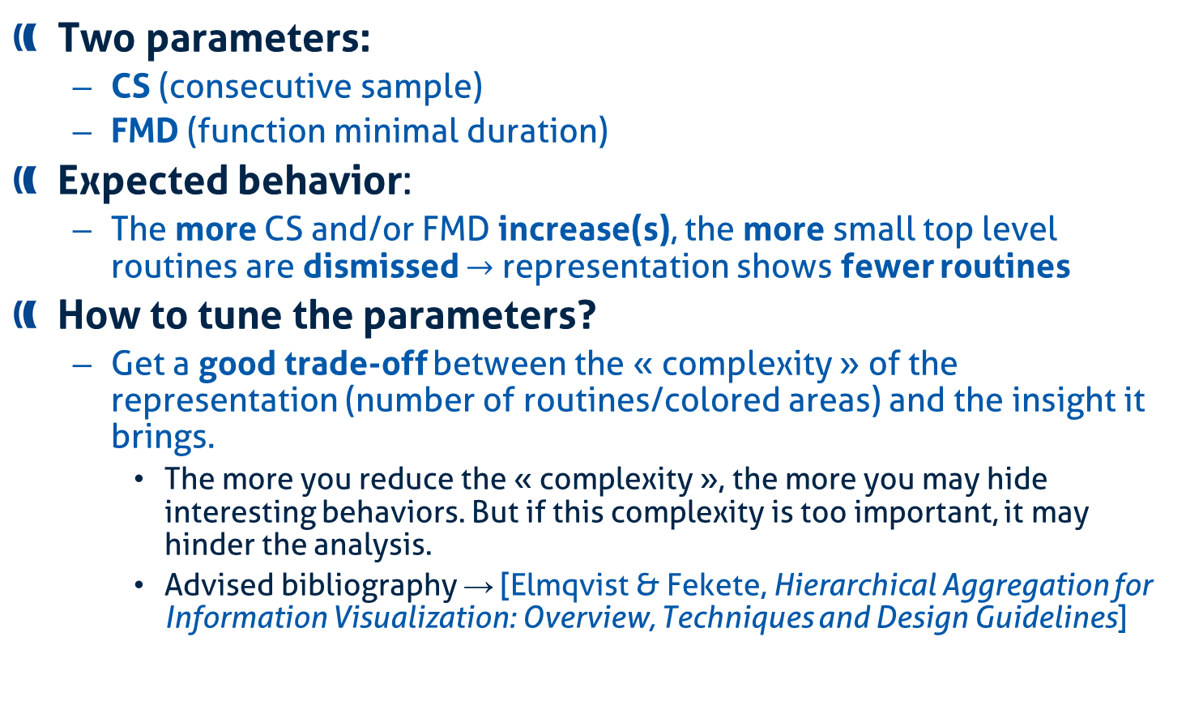
How to generate a good representation ?
Two parameters:
CS (consecutive sample)
FMD (function minimal duration)
Expected behavior:
The more CS and/or FMD increase(s), the more small top level routines are dismissed $→$ representation shows fewer routines
How to tune the parameters?
Get a good trade-off between the « complexity » of the representation (number of routines/colored areas) and the insight it brings.
The more you reduce the « complexity », the more you may hide interesting behaviors. But if this complexity is too important, it may hinder the analysis.
Advised bibliography → [Elmqvist & Fekete, Hierarchical Aggregation for Information Visualization: Overview, Techniques and Design Guidelines]

Slide 12
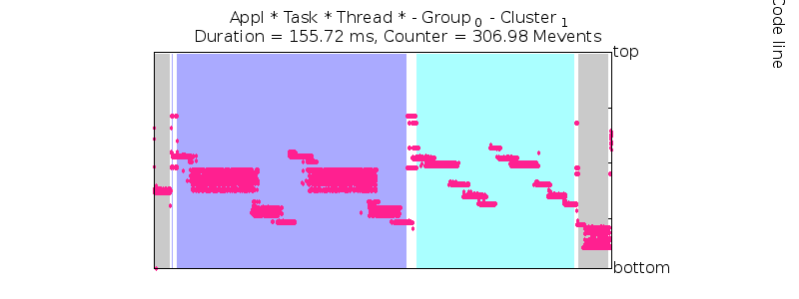

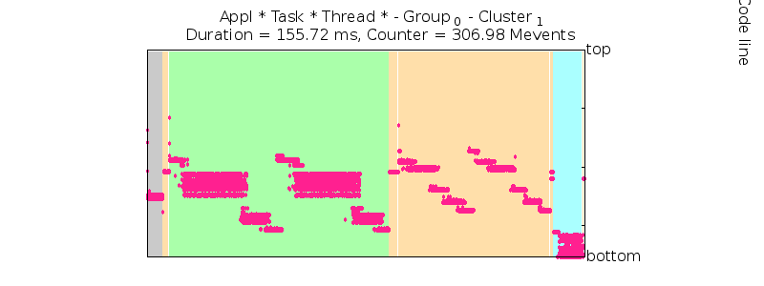
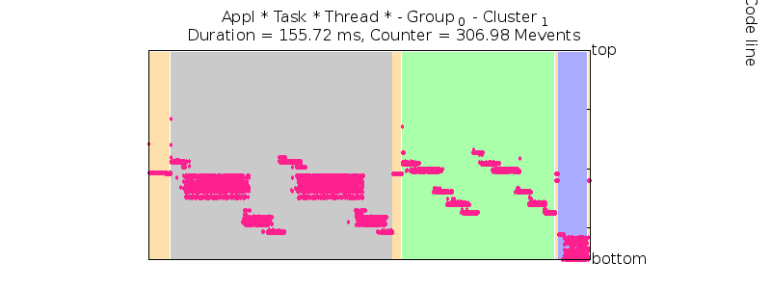

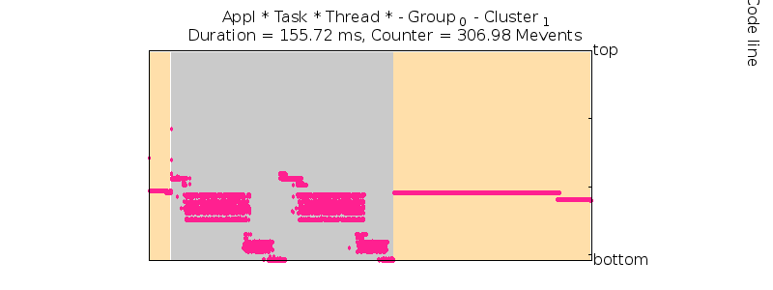

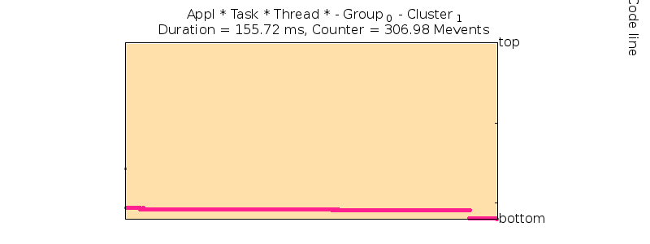
Example of the influence of the parameters
Nemo 128 (Example trace)
CS=2
FMD=0%
CS=3
FMD=2%
CS=20
FMD=5%
CS=20
FMD=40%
CS=50
FMD=80%

Slide 13
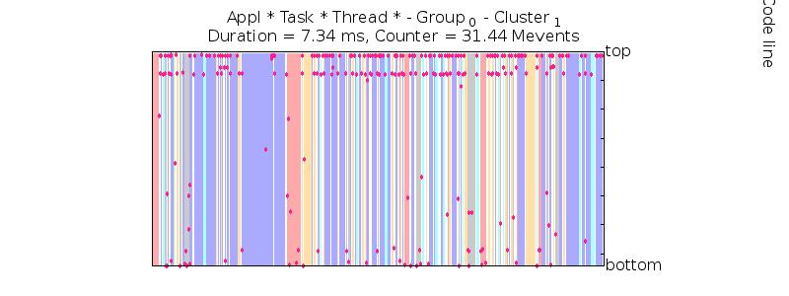
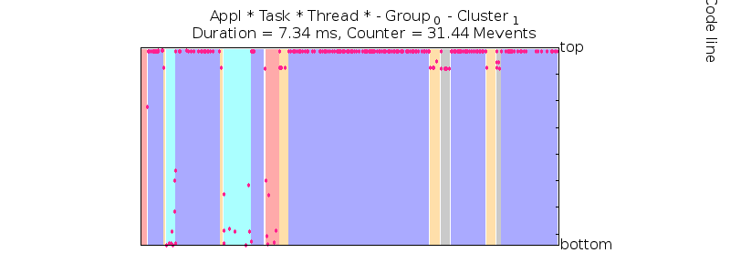
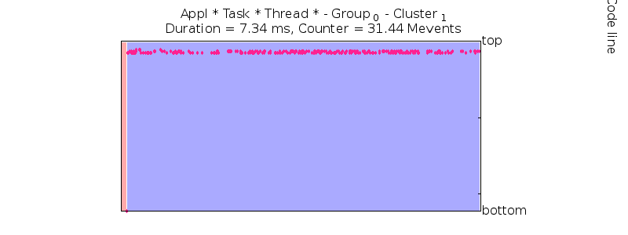
Example of the influence of the parameters
BT B 16
CS=2
FMD=0%
CS=3
FMD=2%
CS=20
FMD=5%
CS=20
FMD=40%
CS=50
FMD=80%

Slide 14

Let’s observe the influence of the parameters
Difference: quantity of dots (= code line associated to a sample) that are different from a reference model (CS,FMD)=2,0.0 (in %)
Sample, Line, Function
0.1, 100, 200
0.2, 250, 345
0.3, 102, 200
Sample, Line, Function
0.1, 100, 200
0.2, 101, 200 --- 1 difference
0.3, 102, 200
Interpretation: Difference is the number (or %) of functions that have been discarded (in comparison with the most fidel representation)
Should be monotonic (increasing): if a function is discarded for (CS,FMD)= X1,Y1, then it must be discarded for (CS,FMD)= X2,Y2, with X2 > X1 and Y2 > Y1.

Slide 15
Nemo 128: Difference vs CS (Cluster 1)
Difference is mainly influenced by FMD, excepted for FMD < 3

Slide 16
Nemo 128: Difference vs CS (zoom on FMD < 10)
Difference is mainly influenced by FMD, excepted for FMD < 3

Slide 17
Nemo 128: Difference vs FMD
Overlapping corroborates the weak influence of CS

Slide 18
Bubble plot: Difference vs CS vs FMD (log10/log10)
This representation shows that Difference is mainly dependent on FMD

Slide 19
Bubble plot: Difference vs CS vs FMD (log10/log10)
Notes:
TODO: refaire 2e figure en mode log10

Slide 20
Bubble plot: Difference vs CS vs FMD (log10/log10)
Notes:
TODO: refaire 2e figure en mode log10

Slide 21

Let’s observe the influence of the parameters (2)
Complexity: number of « colored areas » (consecutive code lines that belong to the same function)
…
Sample, Line, Function
0.1, 100, 200
0.2, 250, 345
0.3, 102, 200
0.4, 105, 200
1
2
3
Interpretation: number of graphical objects contained in the representation. The more it increases, the more we need to make efforts to read, understand and interpret the representation.
In the current representation, routines under 0.5% are filtered (white areas), which reduces the graphical complexity. However, we do not take this into account in our measures.

Slide 22
Nemo 128: Complexity VS CS
Complexity is influenced by both CS and FMD

Slide 23
Bubble plot: Complexity vs CS vs FMD

Slide 24
Bubble plot: Complexity vs CS vs FMD

Slide 25
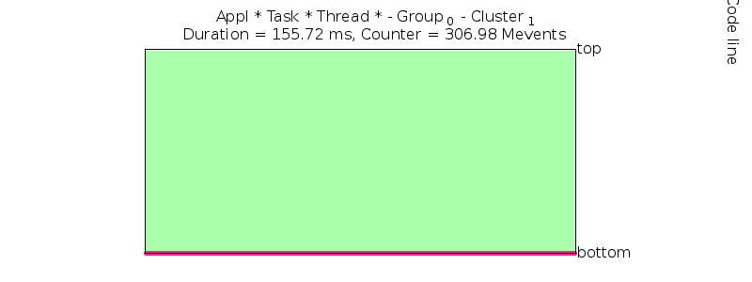



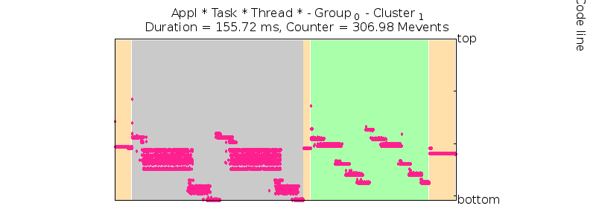
Bubble plot: Complexity vs CS vs FMD

Slide 26
Comparison between Difference and Complexity
For this application:
Difference depend on FMD
Complexity depend on CS and FMD
It means that for a given complexity, it may exist several representations with different differences (and for a given difference, it may exist several representations with different complexities)

Slide 27
Score VS CS VS FMD
We formalize a score, inspired from pIC [Dosimont’s thesis]
Score = - Difference – Complexity (in %)
Can be parametrized:
Score = p * (- Difference) + (1 - p) * (- Complexity). Here, p=0.5

Slide 28
Score VS CS VS FMD
We formalize a score, inspired from pIC [Lamarche-Perrin’s, Dosimont’s theses]
Score = - Difference – Complexity (in %)
Can be parametrized:
Score = p * (- Difference) + (1 - p) * (- Complexity). Here, p=0.5

Slide 29
Find the best representations
Using the score formula, we can select, for different values of p, the representation Rp that has the highest score.
Nemo 128, Cluster 1
Complexity
Reduction
Difference

Slide 30




Find the best representations
Using the score formula, we can select, for different values of p, the representation Rp that has the highest score.
Nemo 128, Cluster 1

Slide 31
Nemo 128 Cluster 1: behavior of the measures

Slide 32
BT B 16 Cluster 1: Difference

Slide 33
BT B 16 Cluster 1: Complexity

Slide 34
BT B 16 Cluster 1: Score (p=0.5)

Slide 35
BT B 16 Cluster 1

Slide 36
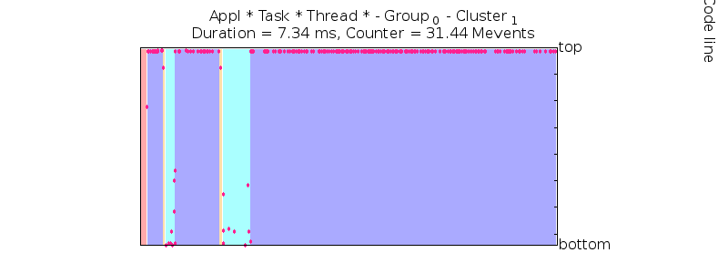
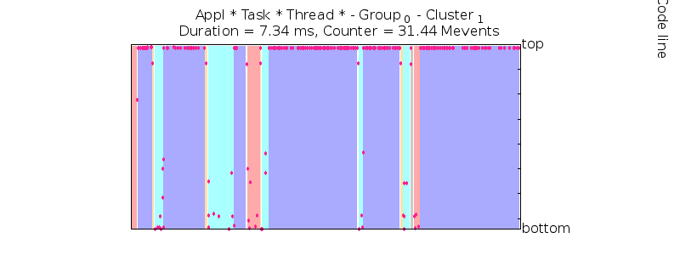
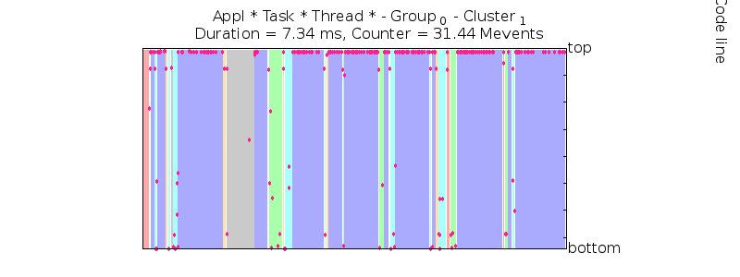
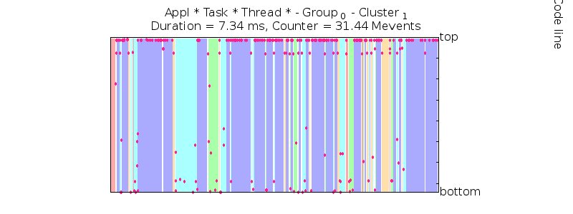
BT B 16 Cluster 1

Slide 37
BT B 16 Cluster 1: Difference vs Complexity

Slide 38
First approach: Evaluation

Slide 39
Unexpected behaviors detected
Nemo 128 (example trace), Cluster 2

Slide 40
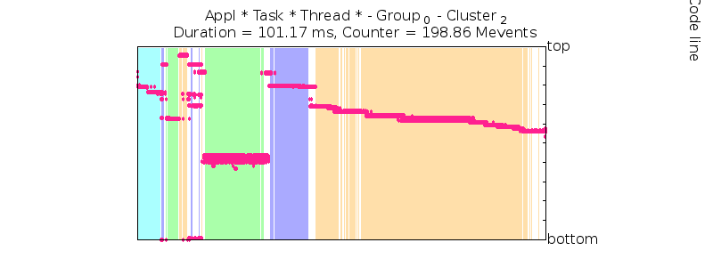
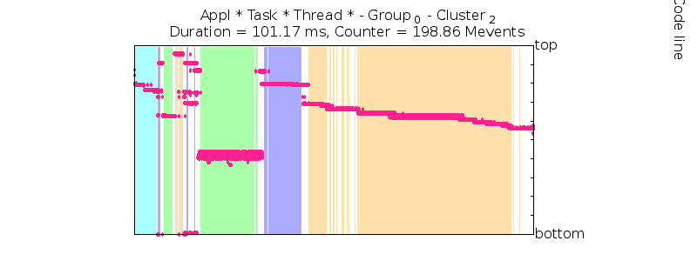
Unexpected behaviors detected
Complexity: Nemo 128 (example trace), Cluster 2

Slide 41
Unexpected behaviors detected
BT.C.100 Cluster 2

Slide 42
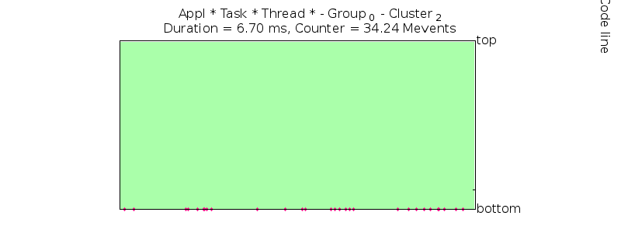
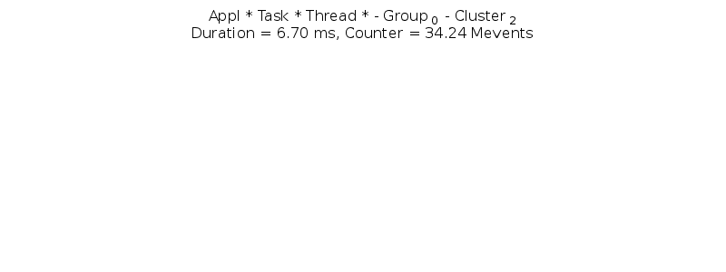
Unexpected behaviors detected
BT.C.100 Cluster 2

Slide 43
Insight provided by these experiments
Understand the global behavior of the RRI and its parameters influence
varies a lot according to the application and to the clustering/tracing/sampling settings
Highlight the difficulty of tuning these parameters
Bugs/unexpected behavior detected
non monotonic complexity
empty representations
May help to select a better representation if default parameters are not satisfying
The insight of these measures is easy to understand

Slide 44
Main drawbacks
Time costly:
need to compute RRI with different CS/FMD to select the best representation (more than 100 iterations)
Reliability/insight of the measures doubful:
Complexity is not always monotonic
Size of the areas (functions) not taken into account in the complexity
Is the difference a good measure to appreciate the information lost?
Reference model is CS,FMD=2,0
Theory information measures provide more insight
In some cases, representations provided by the algorithm are less interesting (from an analysis point of view) than representations discarded
Visualization issues:
No entity budget management
Overlapping, visualization artifacts
No interaction (zoom, filtering, get more details, visual analytics approach)

Slide 45
Second approach: Aggregation based on information theory

Slide 46
Recall: Dosimont’s thesis
Aggregation method based on information theory measures to build large trace overviews
Temporal aggregation
Spatiotemporal aggregation
Aggregation is parametrized by the user (more or less aggregation), who is helped by the representation of information loss and complexity reduction metrics
Several steps:
Generation of a microscopic model
Computation of quality measures
Parametrized aggregation
Representation

Slide 47
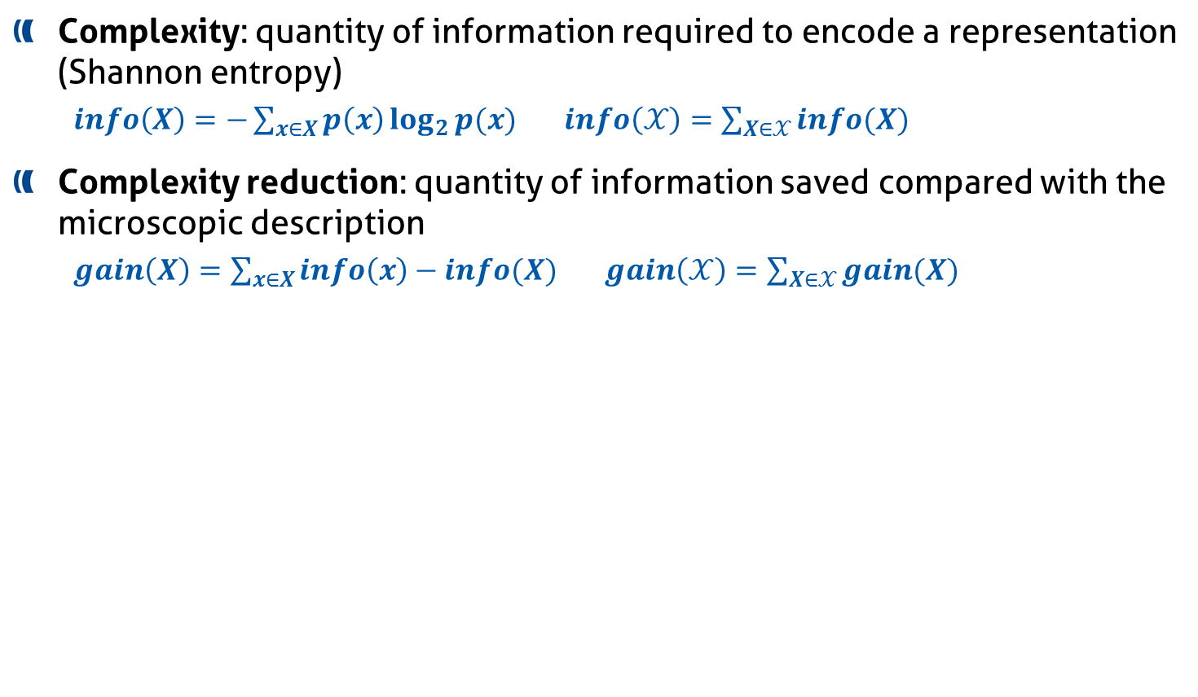
Complexity reduction
Complexity: quantity of information required to encode a representation (Shannon entropy)
$info\left(X\right)=−\sum_{x∈X}{p\left(x\right)\log_{2}{p(x)}}$ $info\left(𝒳\right)=\sum_{X∈𝒳}{info(X)}$
Complexity reduction: quantity of information saved compared with the microscopic description
$gain\left(X\right)=\sum_{x∈X}{info\left(x\right)−info(X)}$ $gain\left(𝒳\right)=\sum_{X∈𝒳}{gain(X)}$
Complexity reduction
5
5
5
1
1
1
1
1
1
9
9
9
2
2
2
4
4
4
Number of elements (aggregates)
Notes:
Formules? Qualité du travail

Slide 48
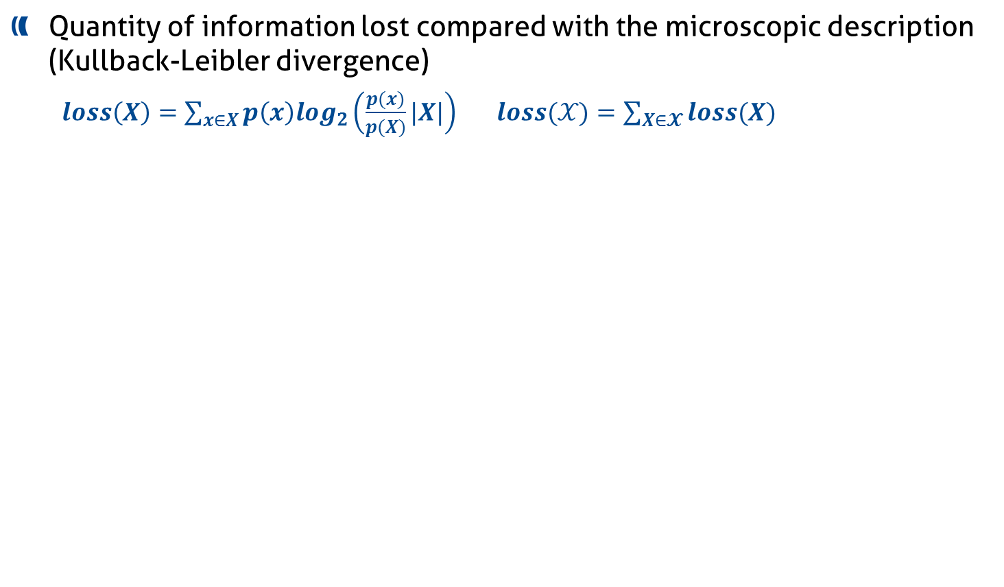
Information loss
Quantity of information lost compared with the microscopic description (Kullback-Leibler divergence)
$loss\left(X\right)=\sum_{x∈X}{p\left(x\right)log_{2}\left(\frac{p(x)}{p(X)}|X|\right)}$ $loss(𝒳)=\sum_{X∈𝓧}{loss(X)}$
5
High
Information Loss
4
1
1
4
4
9
4
4
4
4
4
5
Low
Information Loss
4
4
4
4
4
4
4
4
4
3
4

Slide 49
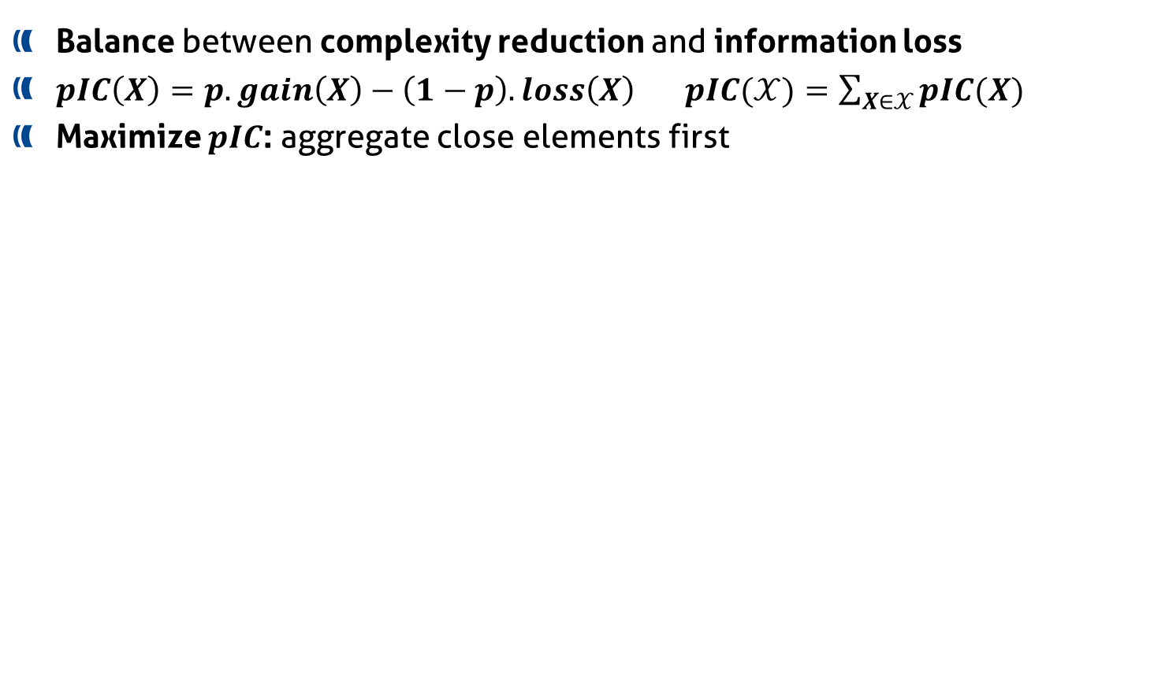
Parametrized Information Criterion
Balance between complexity reduction and information loss
$pIC\left(X\right)=p.gain\left(X\right)−\left(1−p\right).loss\left(X\right)$ $pIC(𝒳)=\sum_{X∈𝒳}{pIC(X)}$
Maximize $pIC$: aggregate close elements first
Complexity reduction
5
9
5
1
1
1
1
1
9
1
2
9
2
2
4
5
4
4
p=0
0<p<1
p=1
Information
Notes:
Quelle est la différence entre gain complexité et perte info? Pourquoi a-t-on besoin des deux? Peut-être pas trop rentrer dans les détails… ou laisser ne question

Slide 50


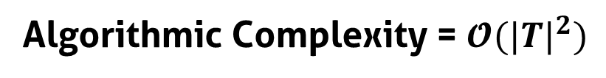
Temporal analysis
Constraint : continuous time intervals
Reduce the number of possible partitions
Bring coherence with syntaxic and semantic characteristics of the system
Algorithmic Complexity = $𝓞({|T|}^{2})$

Slide 51
Discretization
Function calls
Time (continuous)
s1
Tasks
s2
s3
s1
Tasks
s2
s3
t1
t2
t3
t4
t5
Time (discrete)

Slide 52
Task s1 – purple function J5
Microscopic model building
Time (continuous)
s1
Tasks
s2
s3
J5
J4
Functions
J3
J2
J1
s1
s2
Tasks
s3
t1
t2
t3
t4
t5
Time (discrete)
Notes:
Toute info sur ce slide, virer ce qui est entre ça et 32
Contribution?
Adaptation/métrique/info multidimensionnelle/-> choix de structure de données
(-> implémentation efficace
Problème passage à l’échelle n’est pas résolu seulement algorithmiquement)

Slide 53
Task s1 – red function J3
Microscopic model building
Time (continuous)
s1
Tasks
s2
s3
J5
J4
Functions
J3
J2
J1
s1
s2
Tasks
s3
t1
t2
t3
t4
t5
Time (discrete)
Notes:
Toute info sur ce slide, virer ce qui est entre ça et 32
Contribution?
Adaptation/métrique/info multidimensionnelle/-> choix de structure de données
(-> implémentation efficace
Problème passage à l’échelle n’est pas résolu seulement algorithmiquement)

Slide 54
Task s1 – blue function J1
Step 2: microscopic model building
Time (continuous)
s1
Tasks
s2
s3
J5
J4
Functions
J3
J2
J1
s1
s2
Tasks
s3
t1
t2
t3
t4
t5
Time (discrete)
Notes:
Toute info sur ce slide, virer ce qui est entre ça et 32
Contribution?
Adaptation/métrique/info multidimensionnelle/-> choix de structure de données
(-> implémentation efficace
Problème passage à l’échelle n’est pas résolu seulement algorithmiquement)

Slide 55
Task s2
Step 2: microscopic model building
Time (continuous)
s1
Tasks
s2
s3
J5
J4
Functions
J3
J2
J1
s1
s2
Tasks
s3
t1
t2
t3
t4
t5
Time (discrete)
Notes:
Toute info sur ce slide, virer ce qui est entre ça et 32
Contribution?
Adaptation/métrique/info multidimensionnelle/-> choix de structure de données
(-> implémentation efficace
Problème passage à l’échelle n’est pas résolu seulement algorithmiquement)

Slide 56
Whole microscopic model
Microscopic model building
Time (continuous)
s1
Tasks
s2
s3
J5
J4
Functions
J3
J2
J1
s1
s2
Tasks
s3
t1
t2
t3
t4
t5
Time (discrete)
Notes:
Toute info sur ce slide, virer ce qui est entre ça et 32
Contribution?
Adaptation/métrique/info multidimensionnelle/-> choix de structure de données
(-> implémentation efficace
Problème passage à l’échelle n’est pas résolu seulement algorithmiquement)

Slide 57

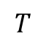
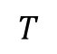
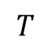
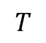
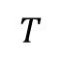
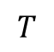
Visualize the trace abstraction
Bar chart
$$T$$
Colored
partition
$$T$$
$$T$$
Stacked bar
chart
$$T$$
$$T$$
Mode
$$T$$
Spatial aggregation
Aggregation of event types
[D., Schnorr et al., RR-8524, Inria]
Notes:
Virer 40, 41, 42 car déjà expliqué à gauche

Slide 58
Proposal
The aggregation algorithm is generic and suitable to the analysis of different types of data
Can be applied on the data generated by the sampling, which represents the sequence of function calls
Two approaches :
Without preaggregation
With preaggregation

Slide 59
Step 1: MSA Alignment
Input model is generated from the function calls after applying MSA alignement
Top
f_{d}
f_{e}
f_{c}
f_{f}
f_{e}
Depth 1
f_{c}
f_{d}
f_{b}
f_{d}
f_{d}
f_{b}
o(f_{b})
o(f_{b})
o(f_{b})
f_{c}
f_{c}
Depth 2
f_{c}
f_{a}
o(f_{a})
o(f_{a})
o(f_{a})
o(f_{a})

Slide 60
Step 2: filling the microscopic model
f_{e}
f_{f}
f_{e}
f_{d}
f_{d}
f_{d}
f_{d}
f_{c}
f_{c}
f_{c}
f_{c}
f_{c}
f_{b}
o(f_{b})
f_{b}
o(f_{b})
o(f_{b})
o(f_{a})
o(f_{a})
f_{a}
o(f_{a})
o(f_{a})
f_{f}
0
0
0
1
0
f_{e}
0
1
0
0
1
f_{d}
1
1
0
1
1
f_{c}
1
1
1
1
1
f_{b}
1
1
1
1
1
f_{a}
1
1
1
1
1

Slide 61
Step 3: apply the aggregation
f_{f}
0
0
0
1
0
f_{e}
0
1
0
0
1
f_{d}
1
1
0
1
1
f_{c}
1
1
1
1
1
f_{b}
1
1
1
1
1
f_{a}
1
1
1
1
1
p_{a}=0
p_{b}> p_{a}
p_{c}> p_{b}
p_{d}> p_{c}
p_{e}=1

Slide 62
Step 3: apply the aggregation
f_{f}
0
0
0
1
0
f_{e}
0
1
0
0
1
f_{d}
1
1
0
1
1
f_{c}
1
1
1
1
1
f_{b}
1
1
1
1
1
f_{a}
1
1
1
1
1
p_{a}=0
p_{b}> p_{a}
Could be automatically selected by analyzing loss and gain curves shape
p_{c}> p_{b}
p_{d}> p_{c}
p_{e}=1

Slide 63
Step 4: generate a represention
f_{e}
f_{f}
f_{e}
p_{c}> p_{b}
f_{d}
f_{d}
f_{d}
f_{d}
f_{c}
f_{c}
f_{c}
f_{c}
f_{c}
f_{b}
o(f_{b})
f_{b}
o(f_{b})
o(f_{b})
o(f_{a})
o(f_{a})
f_{a}
o(f_{a})
o(f_{a})
p_{c}> p_{b}
Topmost level routine that is shared between more than x % of samples
p_{c}> p_{b}
Showing the code lines

Slide 64
Step 4: generate a represention
f_{e}
f_{f}
f_{e}
p_{c}> p_{b}
f_{d}
f_{d}
f_{d}
f_{d}
f_{c}
f_{c}
f_{c}
f_{c}
f_{c}
f_{b}
o(f_{b})
f_{b}
o(f_{b})
o(f_{b})
o(f_{a})
o(f_{a})
f_{a}
o(f_{a})
o(f_{a})
p_{c}> p_{b}
Main top level routine stacked barchart

Slide 65
Pixel and entity budget management
…
f_{e}
f_{f}
f_{e}
…
f_{d}
f_{d}
f_{d}
f_{d}
Let’s imagine we have thousands of samples
f_{c}
f_{c}
f_{c}
f_{c}
f_{c}
f_{b}
o(f_{b})
f_{b}
o(f_{b})
o(f_{b})
o(f_{a})
o(f_{a})
f_{a}
o(f_{a})
o(f_{a})

Slide 66
Pixel and entity budget management
…
f_{e}
f_{f}
f_{e}
…
f_{d}
f_{d}
f_{d}
f_{d}
Let’s imagine we have thousands of samples
f_{c}
f_{c}
f_{c}
f_{c}
f_{c}
f_{b}
o(f_{b})
f_{b}
o(f_{b})
o(f_{b})
o(f_{a})
o(f_{a})
f_{a}
o(f_{a})
o(f_{a})
<1px
<1px
<1px
<1px
<1px
…
>1px
<1px
>1px
Representation issue !

Slide 67
Preaggregation
…
f_{e}
f_{f}
f_{e}
f_{d}
f_{d}
f_{d}
f_{d}
f_{c}
f_{c}
f_{c}
f_{c}
f_{c}
f_{b}
o(f_{b})
f_{b}
o(f_{b})
o(f_{b})
o(f_{a})
o(f_{a})
f_{a}
o(f_{a})
o(f_{a})
f_{f}
0
0.5
…
f_{e}
0.5
0
…
f_{d}
1
0.5
…
f_{c}
1
1
…
f_{b}
1
1
…
f_{a}
1
1
…
>1px

Slide 68
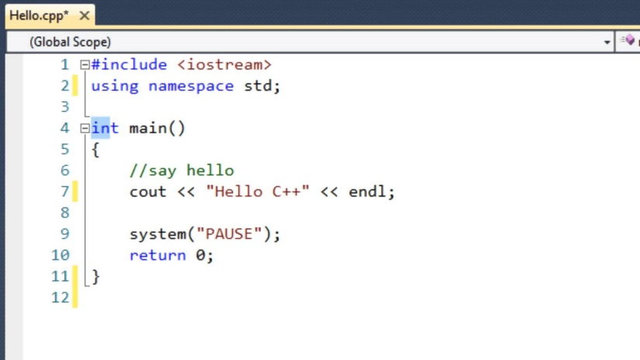

Bring more insight to the user
Interaction :
Basic interaction features: zoom, filter etc.
Visual analytics approach
Hovering/clicking with the mouse automatically highlights the corresponding line in the source code

Slide 69
Bring more insight to the user
Deeper information about function calls
Ex: Markov chain
f_{e}
f_{f}
f_{e}
f_{d}
f_{d}
f_{d}
f_{d}
f_{c}
f_{c}
f_{c}
f_{c}
f_{c}
f_{b}
o(f_{b})
f_{b}
o(f_{b})
o(f_{b})
o(f_{a})
o(f_{a})
f_{a}
o(f_{a})
o(f_{a})
1
1
1
1
1
1
1
1
0.5
0.5
0.5
0.5

Slide 70
Third approach: Distinguish phases from the performance metrics

Slide 71
Proposal
Find routines according to the performance metrics behavior
Apply the aggregation algorithm direcly on the performance metrics data

Slide 72
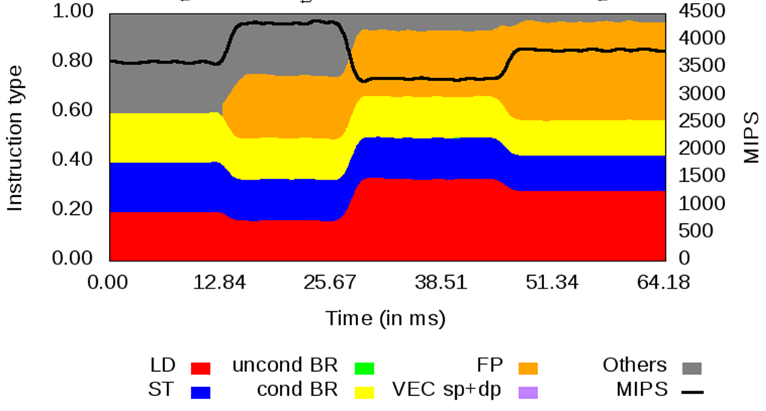
Microscopic model building
…
.8
.8
.8
.8
.8
Normalized
Multicriteria microscopic model
.4
.4
.4
.4
.4
0
0
0
0
0
.2
.2
.2
.2
.2
Raw data
.2
.2
.2
.2
.2
Possibility to define coefficients according to the metrics importance
.2
.2
.2
.2
.2
Sample
1
2
3
4
5
Preaggregation
.8
.8
…
.8
.8
X10
.4
.4
.4
.4
X1
0
0
0
0
X1
.2
.2
.2
.2
X1
.2
.2
.2
.2
X1
.2
.2
.2
.2
X1

Slide 73
Generate a represention
f_{e}
f_{f}
f_{e}
Phases get from performance metrics
f_{d}
f_{d}
f_{d}
f_{d}
f_{c}
f_{c}
f_{c}
f_{c}
f_{c}
f_{b}
o(f_{b})
f_{b}
o(f_{b})
o(f_{b})
o(f_{a})
o(f_{a})
f_{a}
o(f_{a})
o(f_{a})
Aligned routines
Representations similar to the second approach

Slide 74
Thank you!
For further information please contact
damien.dosimont@bsc.es

